Slide 1



Mobile Ad Targeting
Sponsorship Packages
2019 CHEST Annual Meeting

Slide 2
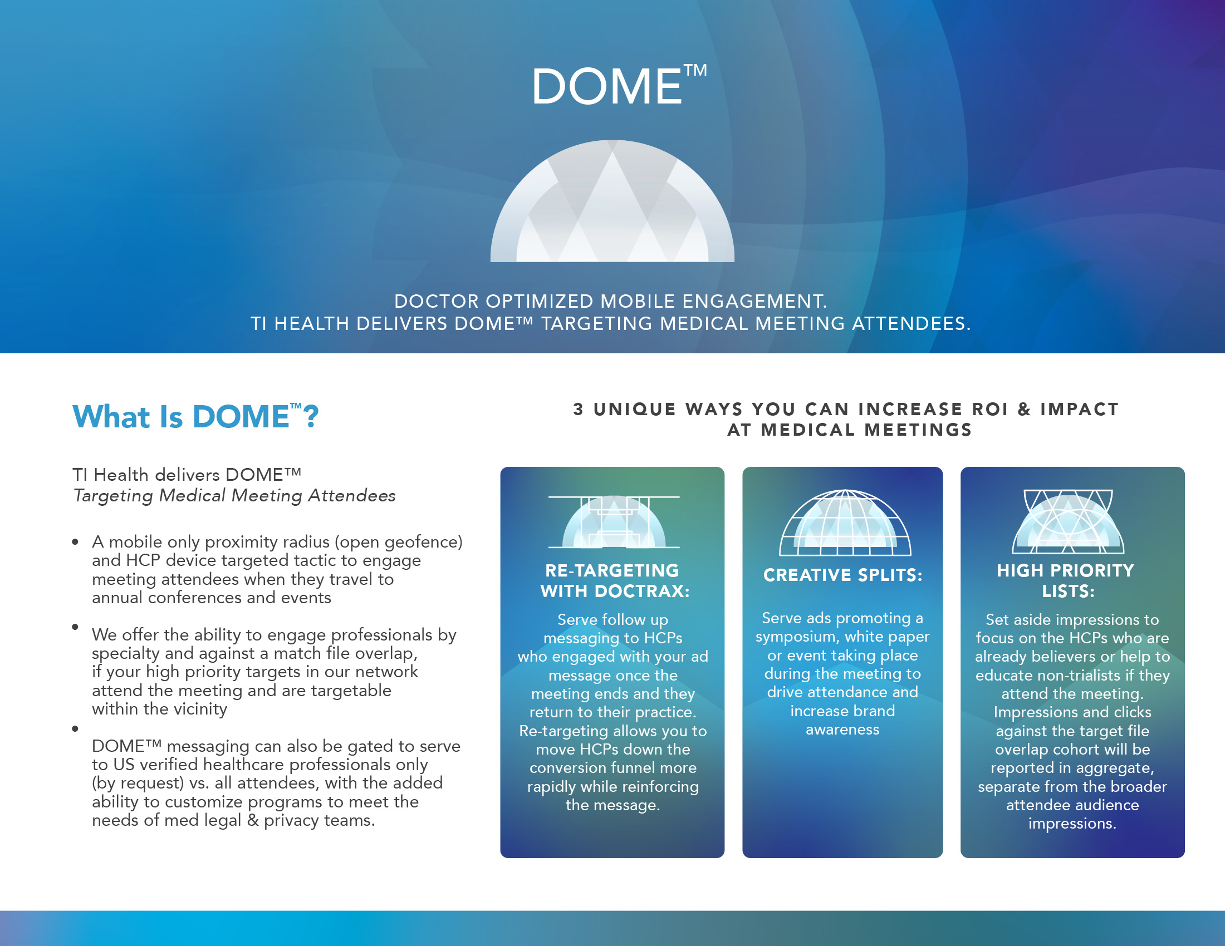

Slide 3

CHEST™ proudly presents mobile sponsorship and media engagement opportunities for our most loyal customers. In partnership with our exclusive digital and mobile ad targeting partners at TI Health™, sponsorship allows you to engage verified meeting registrants and the CHEST member database with time-sensitive mobile ad messaging when they are walking the conference floor, driving proven ROI for our largest brands for more than 5-years running.
Previous campaigns have yielded more than three-times the average click thru-rate, driving everything from booth and foot traffic to symposia to increase unique professional website visits. In addition to targeting meeting registrants and CHEST members at the meeting, we’re now offering the opportunity to re-target registrants and members when the meeting ends, further increasing awareness to your specialists and priority prescribers.
New in 2019, CHEST™ now offers the ability to add match file ad targeting to the meeting, serving ad impressions to an overlap of HCPs on your target or match file with our registration base if they attend the meeting. We’ve also opened up exclusivity in certain disease states. Ads deployed will serve on brand-safe content across mobile web and in-app placements in standard ad sizes.

Slide 4



GOLD PACKAGE: $50,000
Gold Package
What’s Included at the GOLD Level
Meeting Messaging Impact: 250,000 ad impressions (banners or videos) served to the meeting attendees at the convention center and official CHEST hotels
Post Meeting Promotion: 250,000 ad impressions will serve to CHEST members and meeting attendees only, once HCPs return to their home practice. Ads will display for two-weeks post meeting to further drive conversions through to your professional website
Ad Sizes Required: 300x250, 728x90 and 320x50 or 300x500
Reporting: Impressions and clicks will be returned within 3-days of campaign close, showing all impressions, clicks received by ad unit over the lifetime of the program. We can also track on-site conversions with the use of 1x1 pixels to optimize towards specific conversions.

Slide 5

PLATINUM PACKAGE: $100,000
Platinum Package
What’s included at the PLATINUM Level
Meeting Messaging Impact: 500,000 ad impressions (banners or videos) served to the meeting attendees at the convention center and official CHEST hotels
Optimization towards Match File or Target File Messaging: With the Platinum Package, we will also serve ad impressions heavily weighted to priority HCPs we overlap against on any client-supplied match file, if they attend our meeting, further honing in on your priority attendees for conversion.
Post Meeting Promotion: 250,000 ad impressions will serve to CHEST members and meeting attendees only, once HCPs return to their home practice. Ads will display for two-weeks post meeting to further drive conversions through to your professional website
Ad Sizes Required: 300x250, 728x90 and 320x50 or 300x500
Reporting: Impressions and clicks will be returned within 3-days of campaign close, showing all impressions, clicks received by ad unit over the lifetime of the program. We can also track on-site conversions with the use of 1x1 pixels to optimize towards specific conversions.

Slide 6

DIAMOND PACKAGE: $200,000
Diamond Package
What’s Included at the DIAMOND Level: One Available
Meeting Messaging Impact: 500,000 ad impressions (banners or videos) served to the meeting attendees at the convention center and official CHEST hotels
Exclusivity in your Disease State: We will offer exclusivity to a single mobile sponsor wishing to target the CHEST member base and Meeting Attendees in New Orleans and up to 2-weeks post meeting, in specific disease states only. Please inquire as to whether or not exclusivity is still available in your therapeutic area for 2019.
Optimization towards Match File or Target File Messaging: With the Platinum Package, we will also serve ad impressions heavily weighted to priority HCPs we overlap against on any client-supplied match file, if they attend our meeting, further honing in on your priority attendees for conversion.
Post Meeting Promotion: 500,000 ad impressions will serve to CHEST members and meeting attendees only, once HCPs return to their home practice. Ads will display for two-weeks post meeting to further drive conversions through to your professional website
Ad Sizes Required: 300x250, 728x90 and 320x50 or 300x500
Reporting: Impressions and clicks will be returned within 3-days of campaign close, showing all impressions, clicks received by ad unit over the lifetime of the program. We can also track on-site conversions with the use of 1x1 pixels to optimize towards specific conversions.

Slide 7
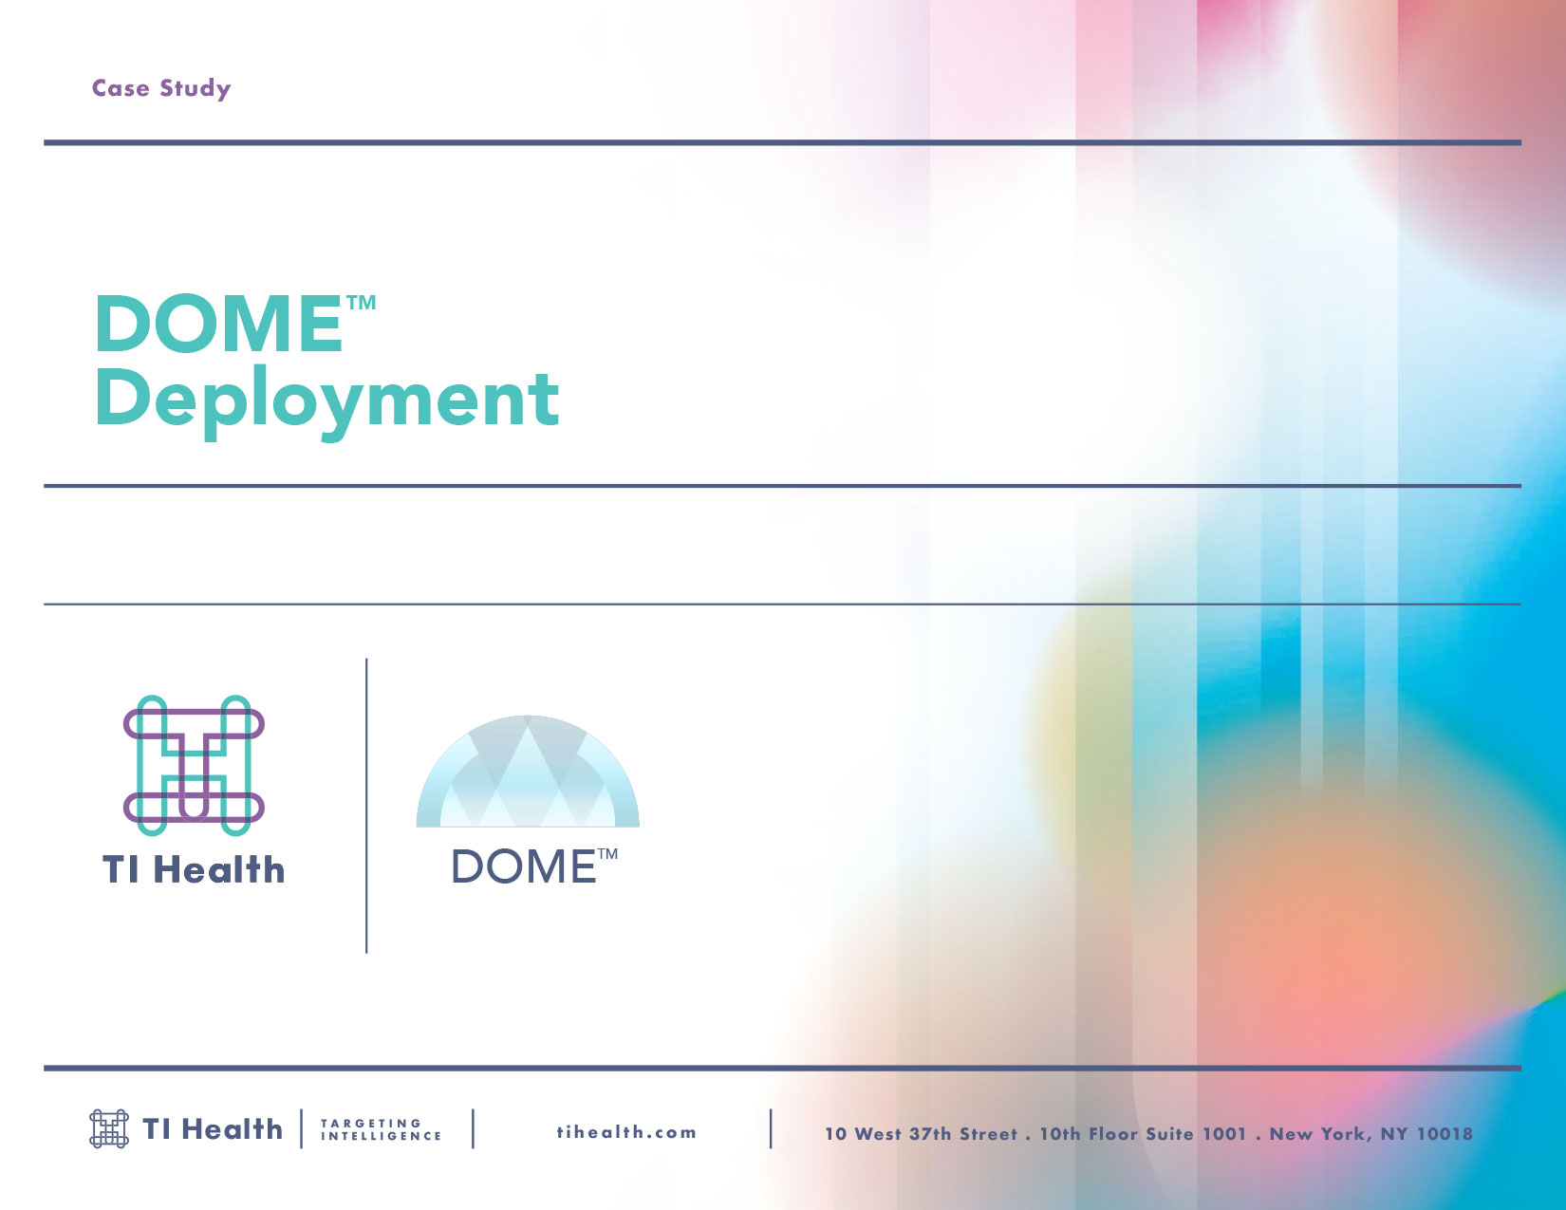

Slide 8
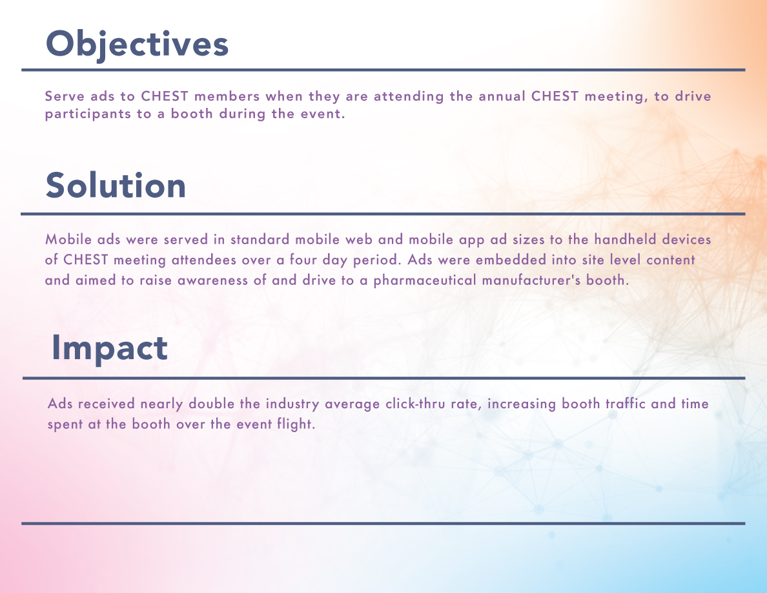

Slide 9
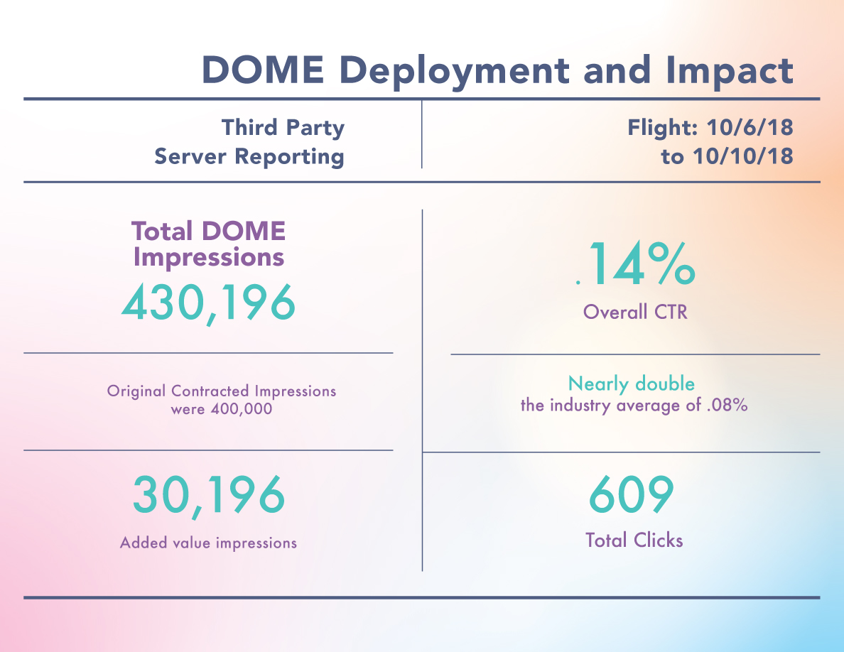

Slide 10
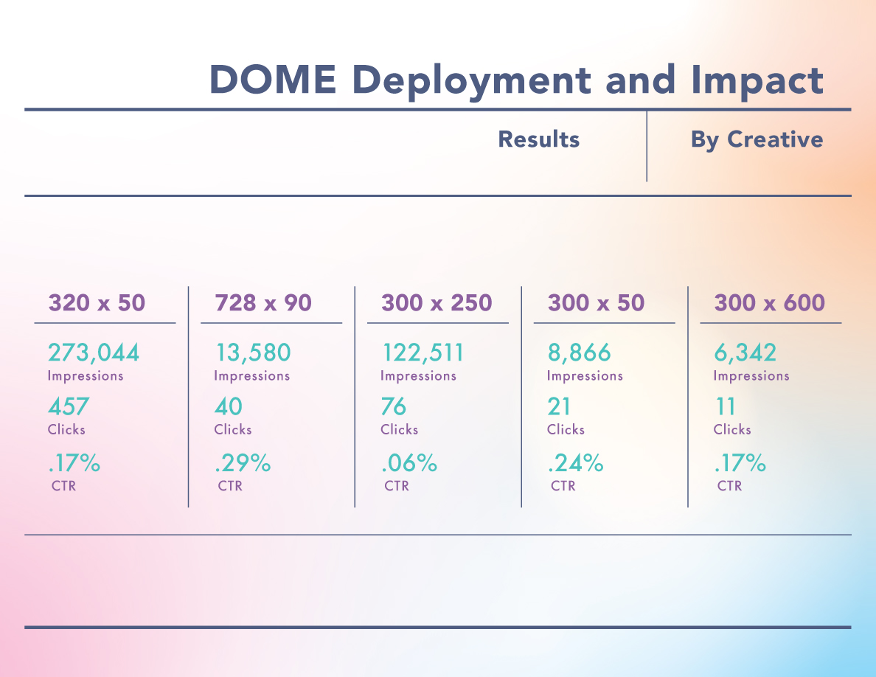

Slide 11

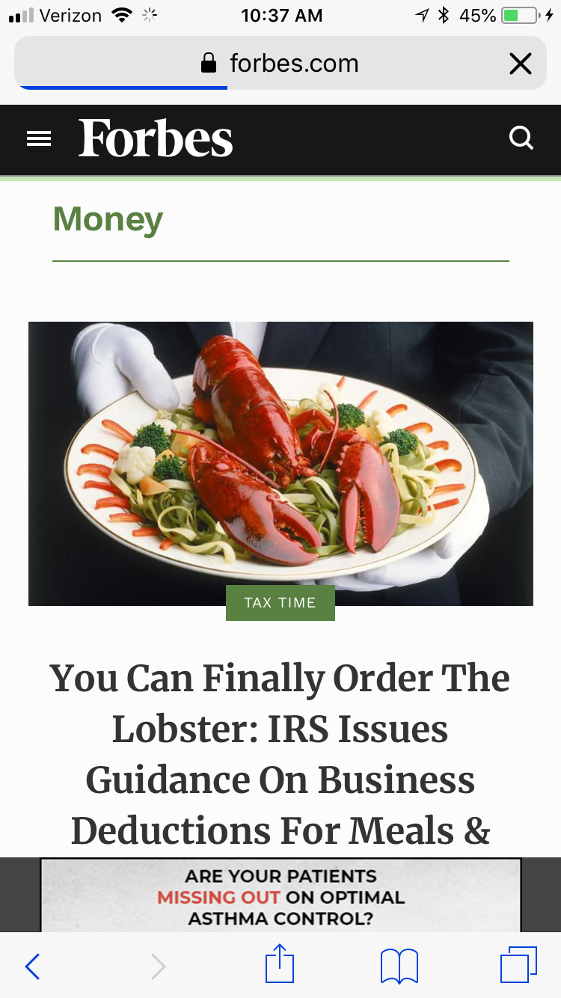
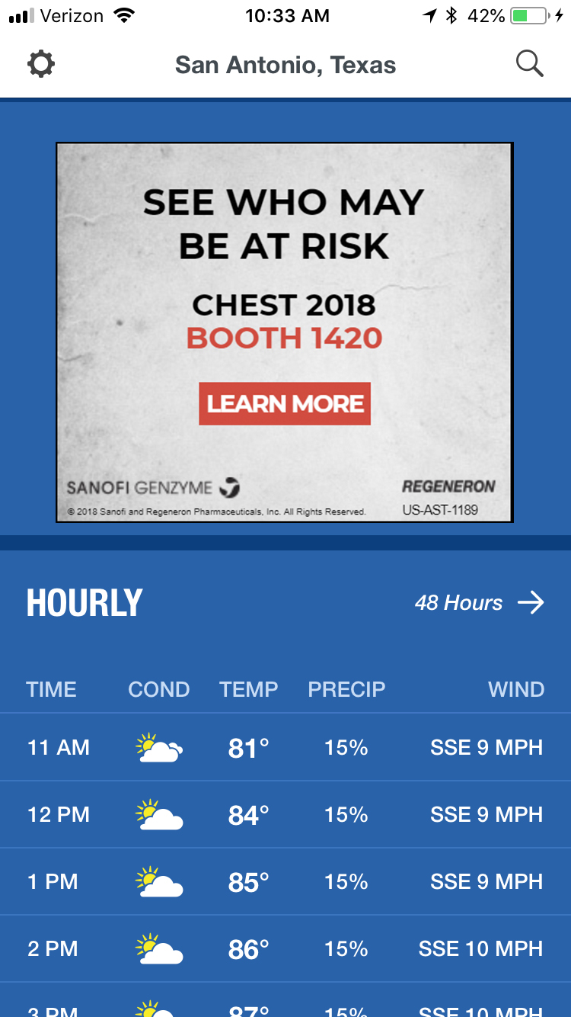
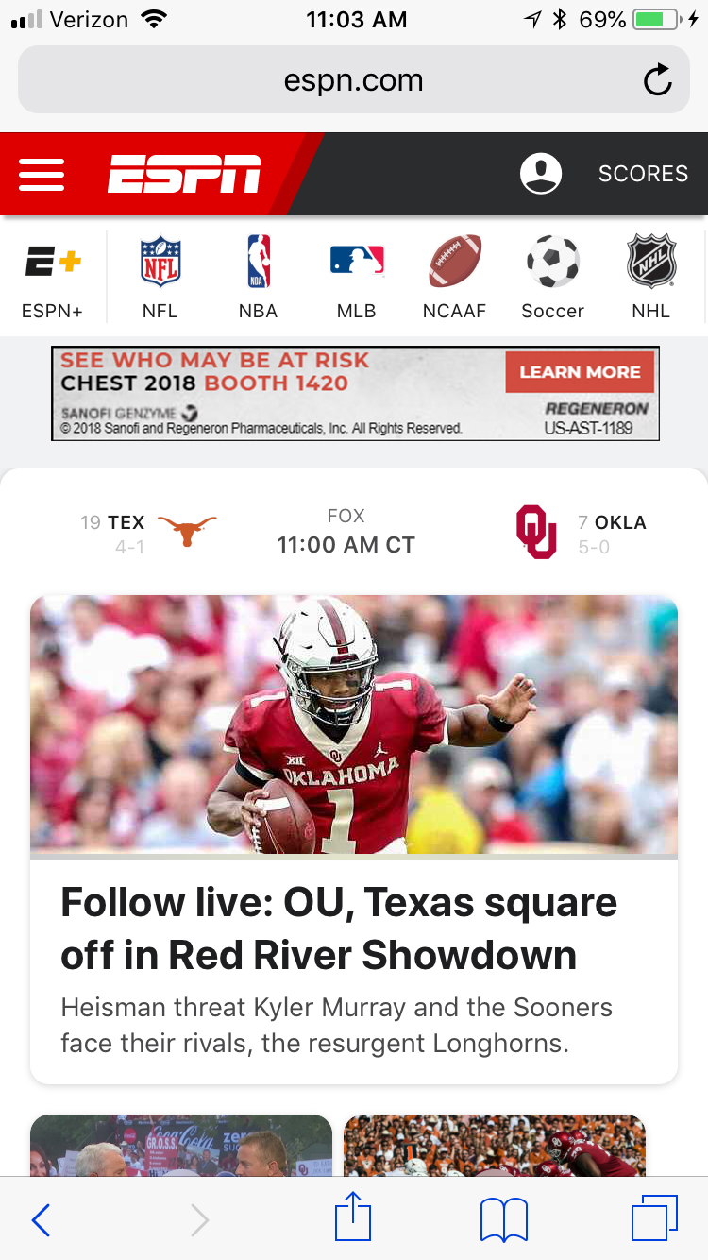
Regeneron Screens

Slide 12
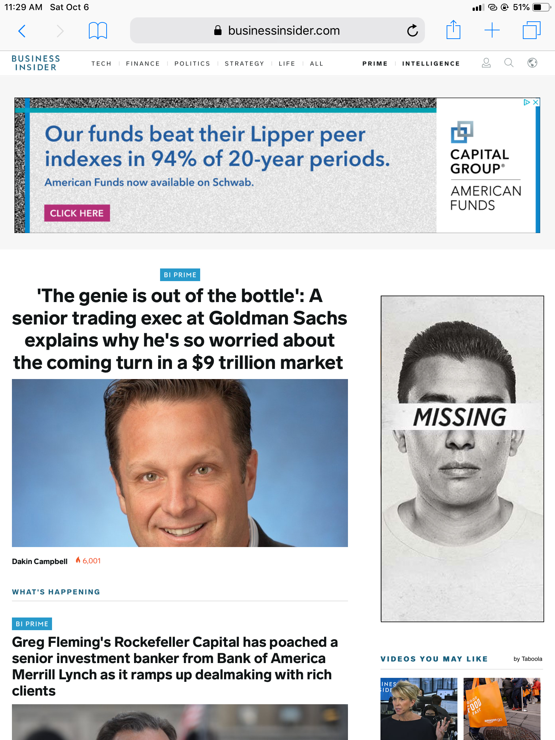
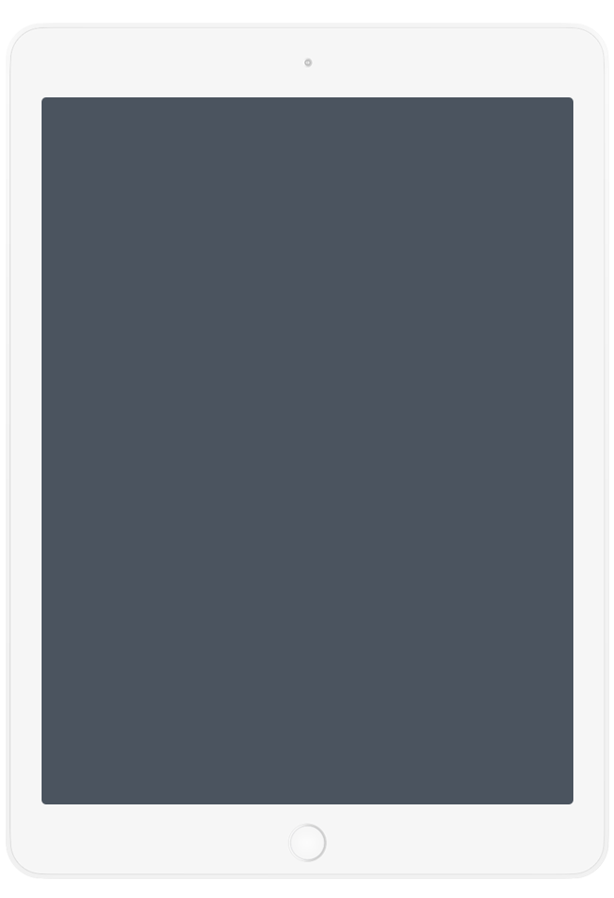
Regeneron Screens

Slide 13
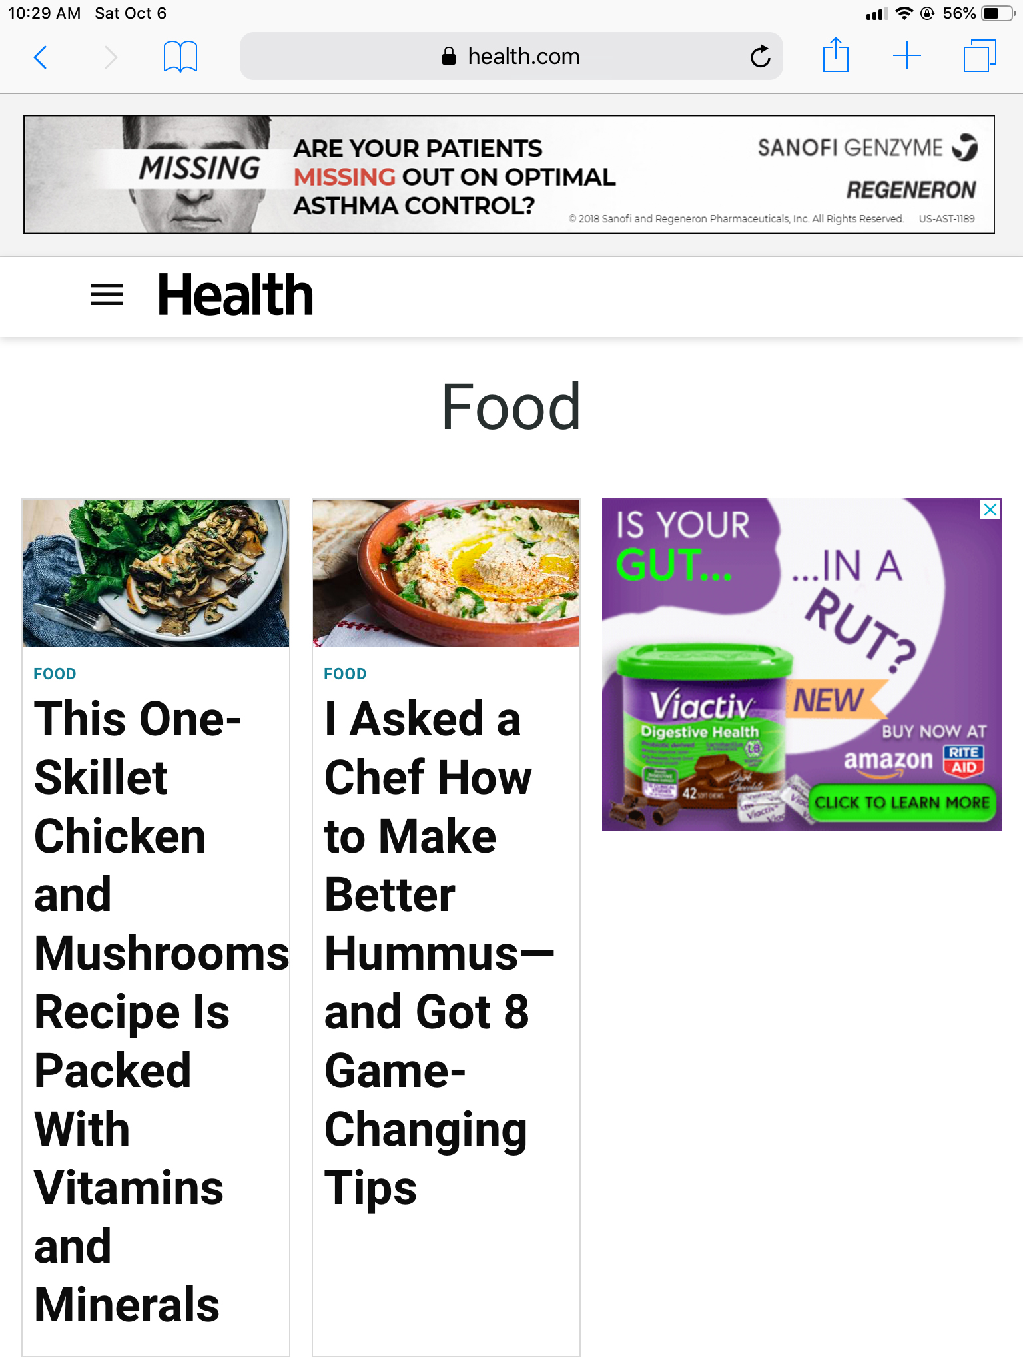
Regeneron Screens

Slide 14
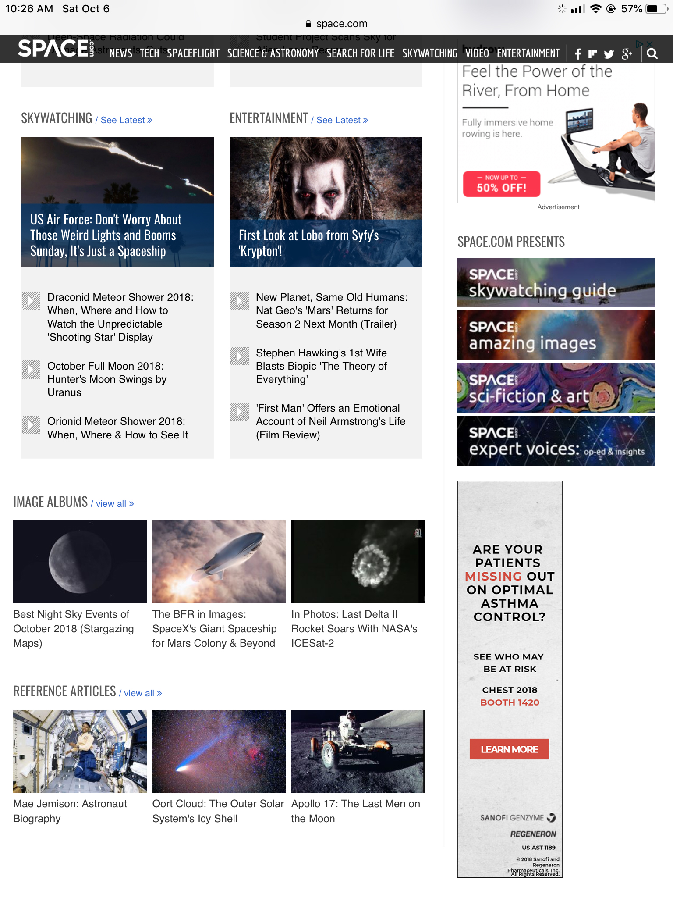
Regeneron Screens

Slide 15

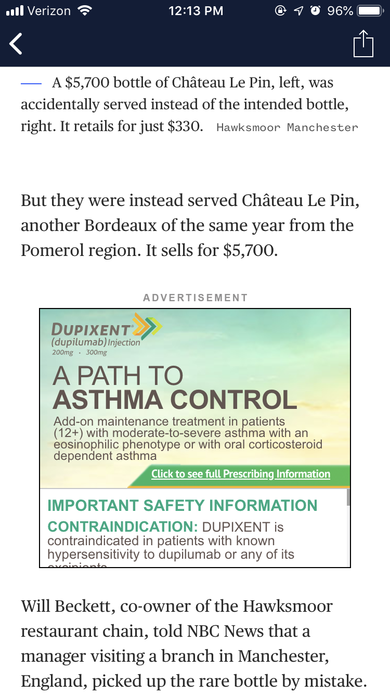
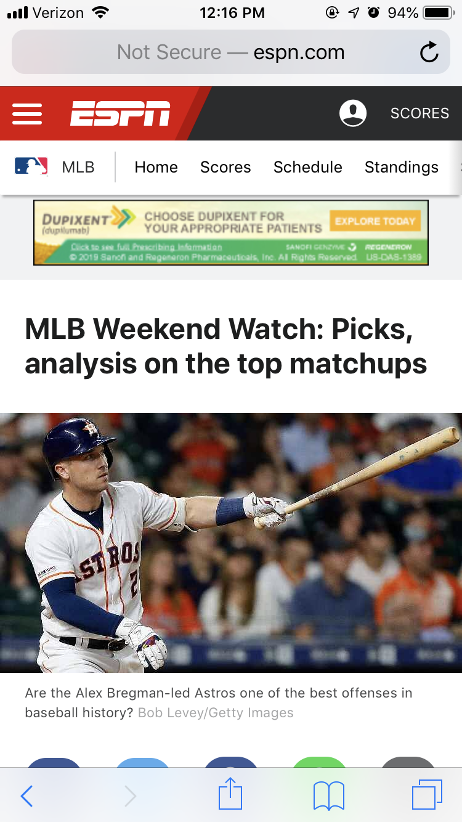
Dupixent Screens

Slide 16
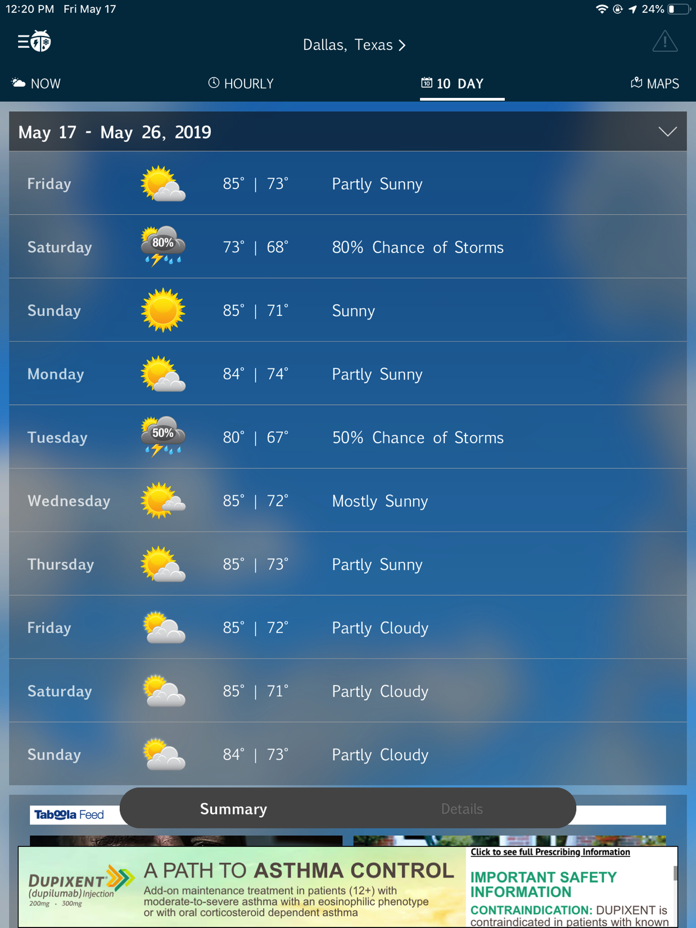
Dupixent Screens

Slide 17


THANK YOU.
NEW YORK
MINNEAPOLIS
SANTA MONICA
10 West 37th Street 10th Floor
New York, NY 10018
3509 W 44th St
Minneapolis, MN 55408
227 Broadway, Suite 201
Santa Monica, CA 90401
www.tihealth.com
hello@tihealth.com

